Slide 1
FINAL YEAR PROJECT
Case study :Unity Club Rwanda (Muhanga Branch)
Submitted by : Bagirishya Rwema Dominique
TOPIC: UNITY CLUB ONLINE REGISTRATION & INTERACTION STSTEM

Slide 2
ORGANIZATION OF STUDY
The work is divided and organized in Five (5) chapters:
Chapter (1) Deals With General introduction
Chapter (2) deals with analysis of existing system and theatrical concepts .
Chapter (3) deals with Research Methodology.
Chapter (4) deals with system Design and Implementation.
Chapter (5) conclusion and recommendations.

Slide 3
CHAP 1:INTRODUCTION
Unity club online registration & interaction means to register people who want to become the members of this club. after registered membership will get interaction between them and administration. Unity club has made significant achievements in developing registration system of membership in recent years. However, the issue of providing adequate clubs online registration & interaction of members has largely been ignored.it was not easy to manage members and keeping records. Also it was difficult to find information on someone who known as member of club. And there was another problem losing interaction between member to members and interaction of administration of club to members.

Slide 4
PROBLEMENT STATEMENT
Today there is no current system that could register and manage all unity club members.
Poor interaction between unity club members and administration.
poor interaction of unity club members around the country.
Nowadays is difficult to announce something to the club membership(manual system is social medias ex ra).
.Poor management of members by administration of unity club.

Slide 5
GENERAL OBJECTIVE
The main objective is to implement a system where all the registered members and their record will be stored in the database, that will help the administration to control and manage them simply. This system will also help to promote the interaction between members( like to charting) . The last one this system will allow the administration to send posts and activities schedules to the members.

Slide 6
SPECIFIC OBJECIVES
The study has the following specific objectives:
Provide online registration of the new comers in unity club.
To promote relationship between unity club memberships and direction.
To promote the way to sponsors to support the club.

Slide 7
SCOPE OF THE STUDY
This project is concerning computerization of “UNITY CLUB ONLINE REGISTRATION AND INTERACTION”. But it is not in charge of the entire department consisting this topic Like ministry of unity and reconciliation; it is only scoped on interaction of members concerning especially the people who make registration and get the way of interacting to the others who make registration.

Slide 8
CHAP 2:ANALYSIS OF EXISTING SYSTEM AND Theatrical CONCEPTS
HOW MANUAL SYSTEM WORK?
The manual system was used by administration of unity club where the only possible way of announcing something to the members was requires to use social medias such as TV and radio announcements.
And Also there was poor interaction between members based in whole county.
PROPOSED SYSTEM
This system will allow administration to send the needed messages and schedules to all members, and will provide good management of registered members
It will promote the relationship between all members in whole country.

Slide 9
PROPOSED SYSTEM REQUIREMENTS
Software requirements
Internet browser software such as Internet Explorer, Mozilla Firefox, Google chrome etc.
Microsoft windows.
Internet (Network).
Smart Phones
Hardware requirements:
The following are minimum hardware requirements for accessing this software:
2GB RAM
2GB Processor
320GB free space of Hard Disk (for PCS) and 8GB (for Smartphones).

Slide 10
Theolical CONSEPTS
System
A collection of components that work together to realize some objective forms a system.
Information
Information is defined as data that have been processed and presented in a form suitable for human interpretation.
Database
A shared collection of logically related data designed to meet the information needs of multiple users in an organization.

Slide 11
CHAP3 RESEARCH METHODOLOGY
METHODOLOGY
The methodology may refer to set of methods or procedures and rules and even steps followed in planning, defining, building, testing and implementing a system. Here as a researcher I prefer to use Waterfall model.
TECHNIQUES USED IN DATA COLLECTION
In my research I used three techniques in data collection: interview, Observation and Internet. These techniques give good output when they are used together to complement one another.
INTERVIEW
This is the technique where system analyst collects information from someone face to face
OBSERVATION
Technique a researcher uses to collect information about an organization when he/she is using his/her eyes and looking day to day the work of existing system of an organization he wants to develop for new system.
INTERNET
For internet allow you to search information According to your need without moving place for going asking people in charge of case study.

Slide 12
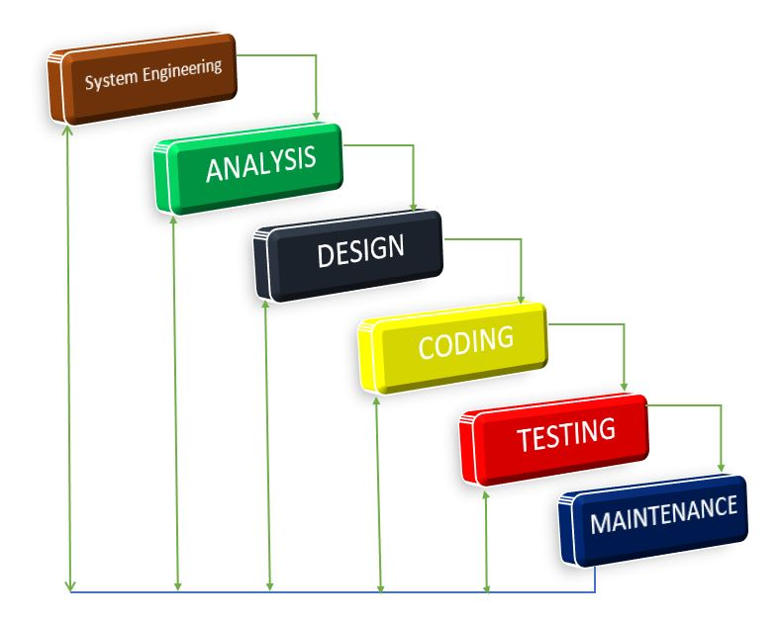

Slide 13
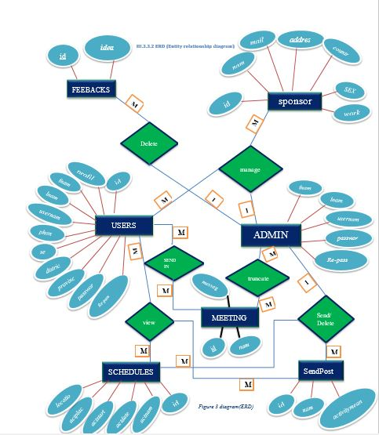
Entity Relationship Diagram of the system

Slide 14
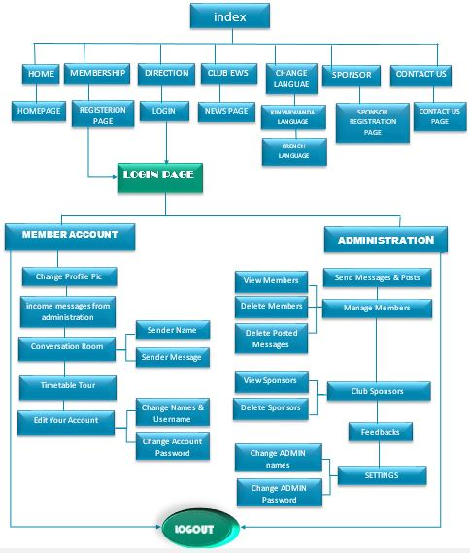
SYSTEM DESIGN

Slide 15
CHAP4: SYSTEM DESIGN AND
IMPLEMENTATION
IMPELENTATION

Slide 16
CONCLUSION
Online unity club registration & Interaction system successfully finished:
During the period of developing this system, I plan a better way, and after I analyze a system that will bring a possible way to all people who want to register in Unity Club, a better way of signing up in the system that will be controlled by Administration unity club. Then after this system will provide the interaction and promote relationship between members and Administration of Unity Club, and even members of such area to the others of another area to easy communicate.
Due to what I wanted to achieve, my project was successfully finished as how it is needed concerned on my level of education and knowledge.

Slide 17
RECOMMENDATION
In Developing This project, I have met with some problems that’s why I recommend to Government and School the following authorities:
To improve the way of bringing all needed information about case studies, like letters, books and other resources (such like increasing computer laboratories) to the student.
To improve and increase bandwidth of internet like (4Glte) in every area of the country not only in zone of cities.
I encourage my previous computer scientist’s young brothers and sisters to Add more functionalities that may led the increase of these final year projects more important.

Slide 18
THANK YOU
PANNEL MEMBERS!
THE END.

